Slide 1

About me
prof. dr. Sven Degroeve​
Master in Informatics, PhD in Computer Sciences​
Computational Omics and Systems Biology Group (CompOmics, prof. dr. Lennart Martens)​
Vakgroep Biomoleculaire Geneeskunde
VIB-UGent Center for Medical Biotechnology​
Machine Learning Methods for Biomedical Data (D012554)

Slide 2


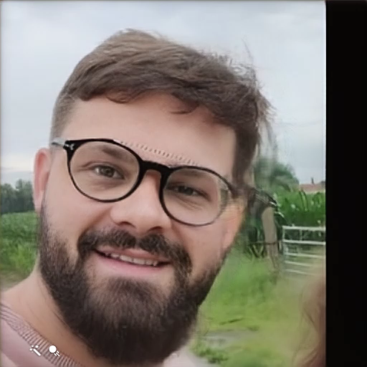



Assistants
dr. Robbin Bouwmeester dr. Ralf Gabriels Toon Callens Tine Clays
Alireza Nameni Arthur Declercq
Machine Learning Methods for Biomedical Data (D012554)

Slide 3
Course specifications
5 credits
contents:
linear regression, logistic regression
support vector machine, random forest, gradient boosting, ensemble learning
deep neural networks, AI
programming with scikit-learn
build and evaluate your own models
final competences:
The student is capable of interacting at high level with data analysis specialists.
The student is capable of understanding the specific literature on machine learning based data analysis.
Machine Learning Methods for Biomedical Data (D012554)

Slide 4
Course specifications
5 credits
contents:
linear regression, logistic regression
support vector machine, random forest, gradient boosting, ensemble learning
deep neural networks, AI
programming with scikit-learn
build and evaluate your own models
final competences:
The student is capable of interacting at high level with data analysis specialists.
The student is capable of understanding the specific literature on machine learning based data analysis.
Machine Learning Methods for Biomedical Data (D012554)

Slide 5
Course specifications
calculation of the examination mark:
(continuous evaluation)
Jupyter notebook project (15%)
microteaching: teach other students about a machine learning method not discussed during the lectures (15%)
2 page report about the obtained Kaggle contest results (20%)
(period-specific evaluation)
written exam on 50% of the total score
Machine Learning Methods for Biomedical Data (D012554)

Slide 6
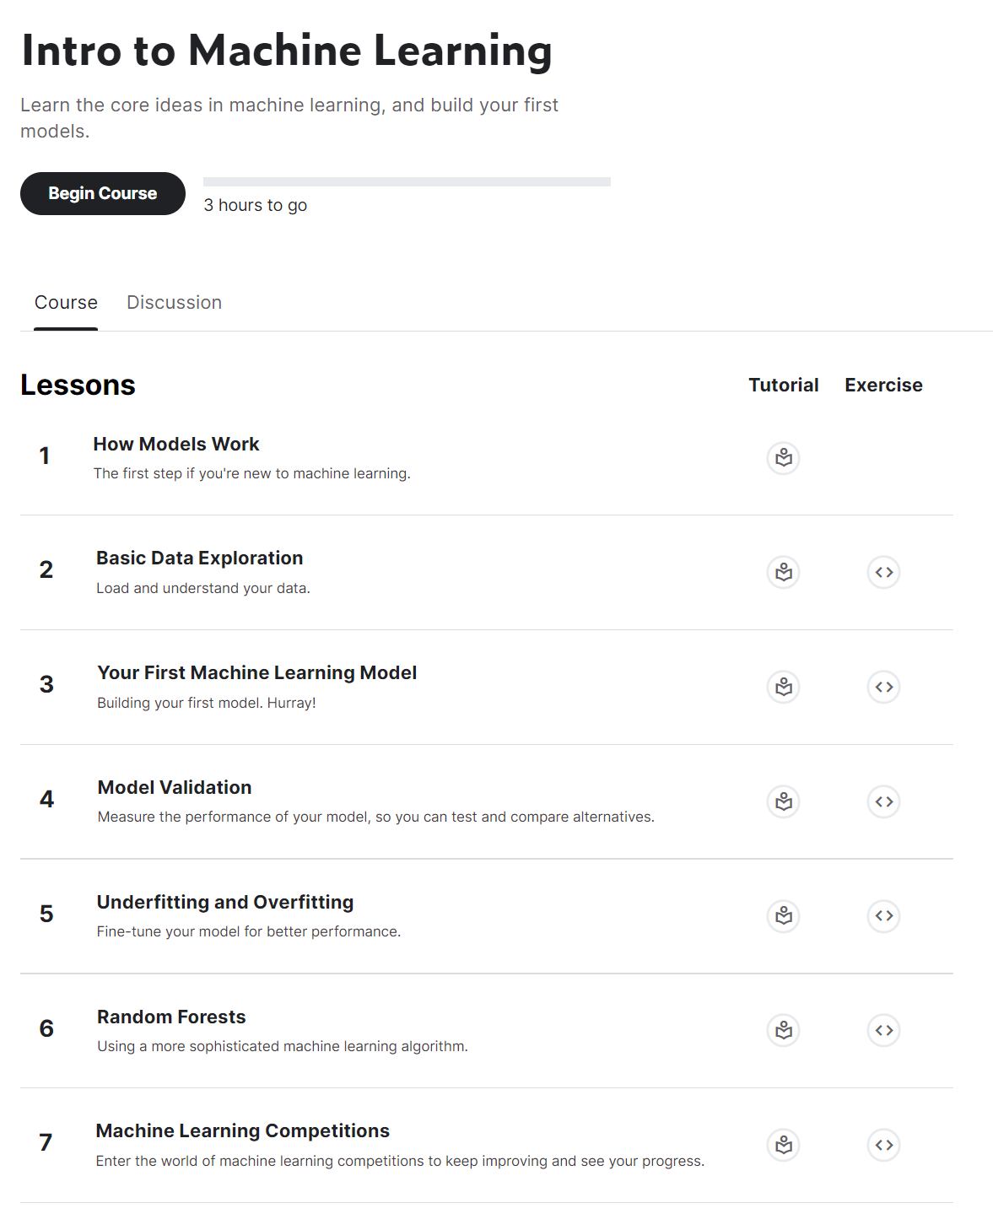
Course specifications
Jupyter notebook project (15%)
Intro to Machine Learning
Intermediate Machine Learning
certificate send to me by email
sven.degroeve@ugent.be
(subject: kaggle certificate)
Machine Learning Methods for Biomedical Data (D012554)

Slide 7
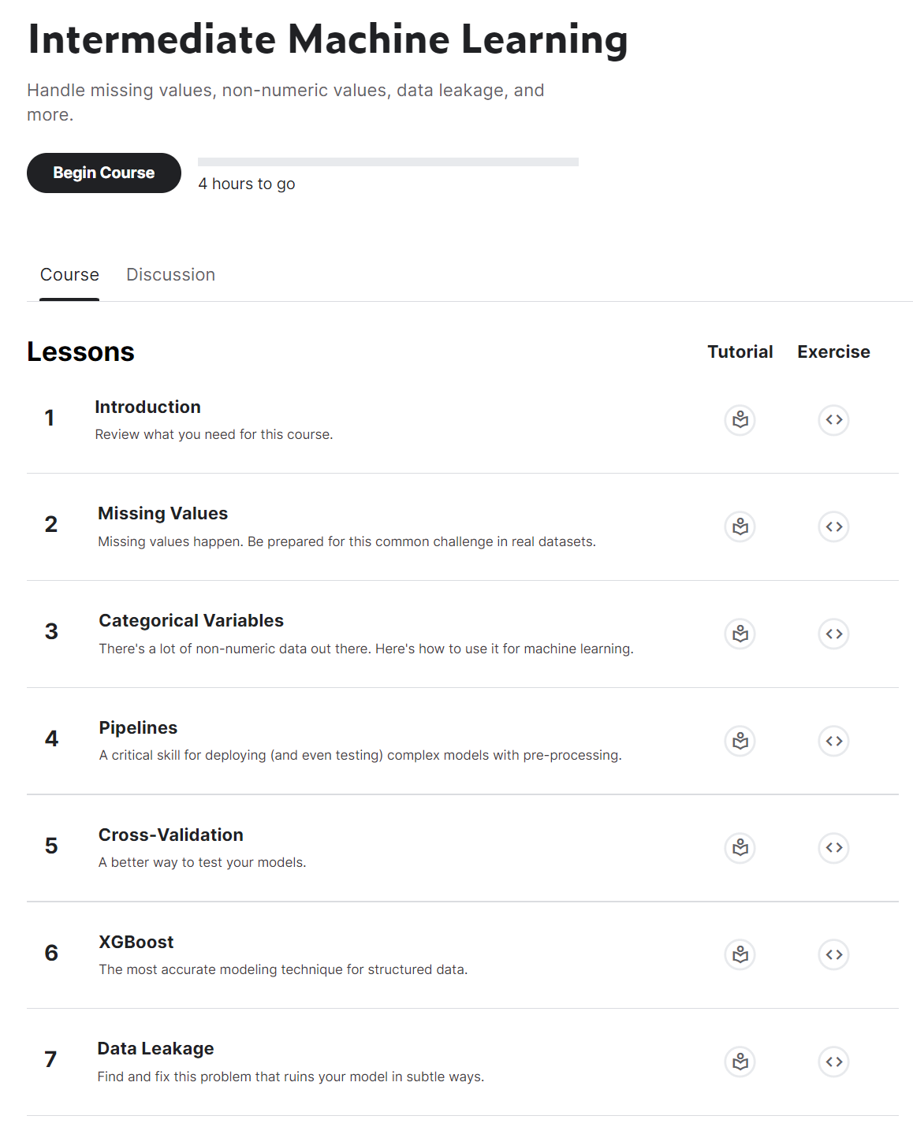
Course specifications
Jupyter notebook project (15%)
Intro to Machine Learning
Intermediate Machine Learning
certificate send to me by email
sven.degroeve@ugent.be
(subject: kaggle certificate)
Machine Learning Methods for Biomedical Data (D012554)

Slide 8
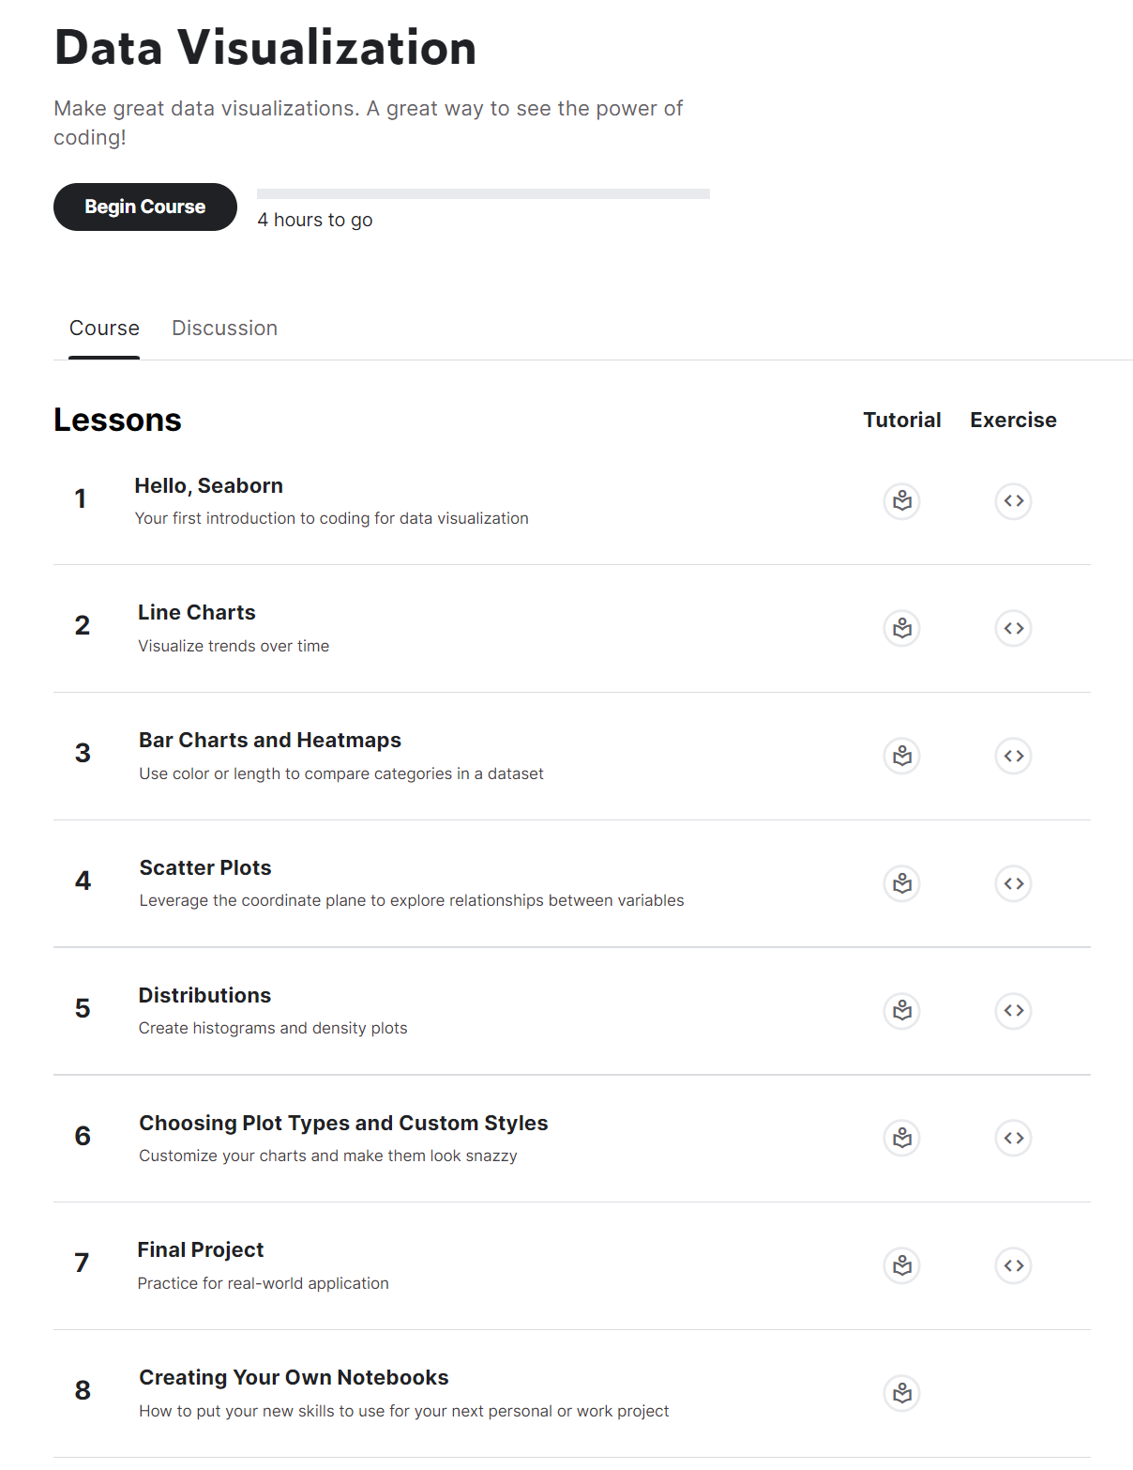
Course specifications
Jupyter notebook project (15%)
Intro to Machine Learning
Intermediate Machine Learning
certificate send to me by email
sven.degroeve@ugent.be
(subject: kaggle certificate)
optional:
Data Visualization
Machine Learning Methods for Biomedical Data (D012554)

Slide 9
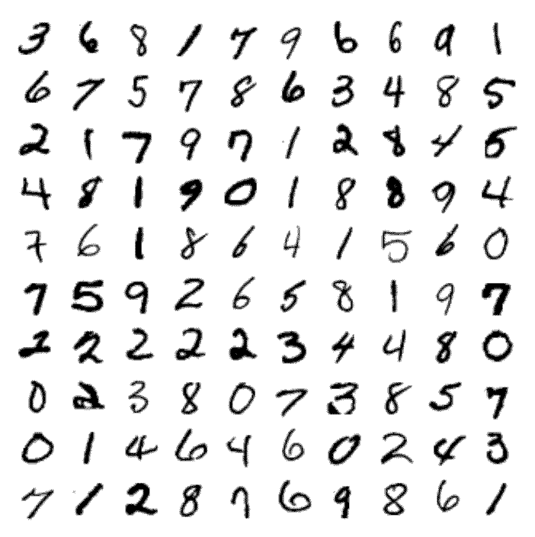
Course specifications
2 page (Calibri (body) font, size 11, A4) report about the obtained Kaggle contest results (20%)
Machine Learning Methods for Biomedical Data (D012554)

Slide 10
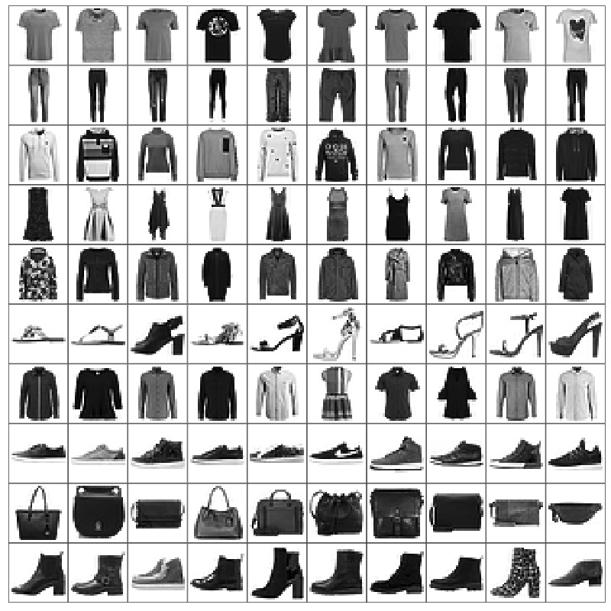
Course specifications
2 page (Calibri (body) font, size 11, A4) report about the obtained Kaggle contest results (20%)
Machine Learning Methods for Biomedical Data (D012554)

Slide 11
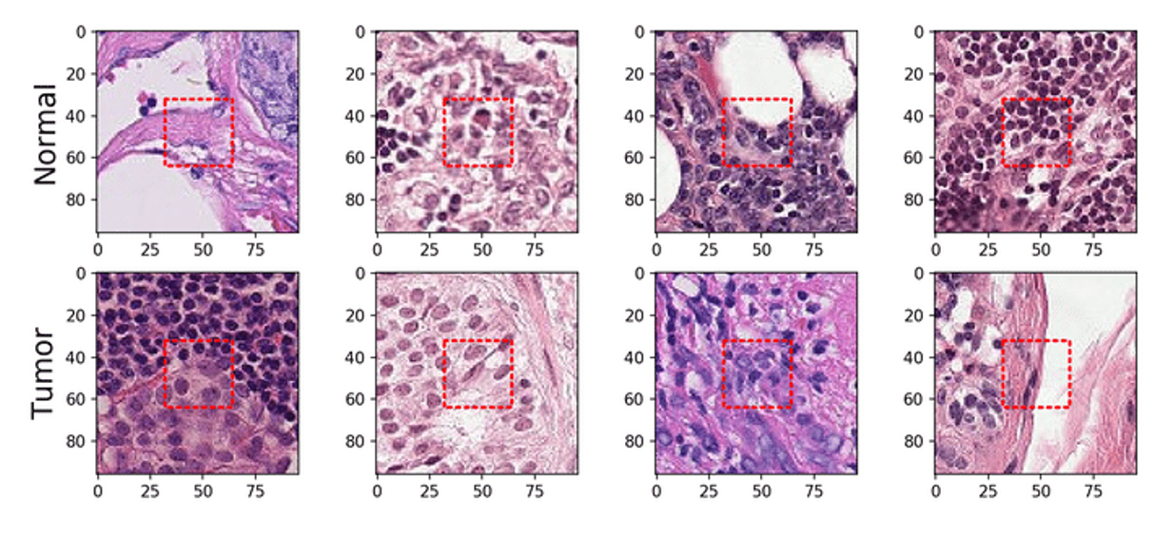
Course specifications
2 page (Calibri (body) font, size 11, A4) report about the obtained Kaggle contest results (20%)
histopathologic scans of lymph node sections
binary label indicating presence of metastatic tissue
Machine Learning Methods for Biomedical Data (D012554)

Slide 12
Course specifications
2 page (Calibri (body) font, size 11, A4) report about the obtained Kaggle contest results (20%)
format: technical report
should contain:
a clear and concise description of the method(s) used to fit your model(s)
(show me you understand what you have done)
a Table with optimal hyperparameter values
a Table with evaluation results (both local CV and leaderboard test set)
a section about what feature(s) are considered most important
a short Discussion section
clear plots are of course allowed as well!
Machine Learning Methods for Biomedical Data (D012554)

Slide 13
Course specifications
microteaching: teach other students about a machine learning method not discussed during the lectures (15%)
Machine Learning Methods for Biomedical Data (D012554)

Slide 14
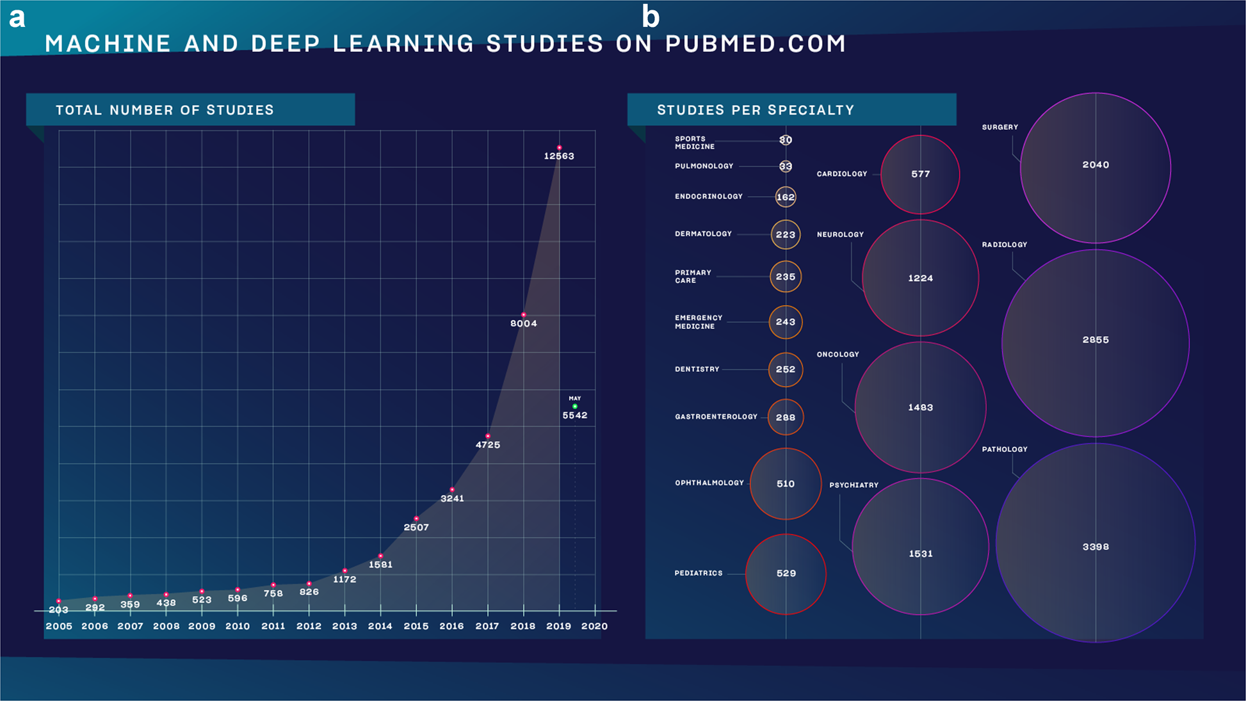
Why follow this course?
Meskó, B., Görög, M. A short guide for medical professionals in the era of artificial intelligence. npj Digit. Med. 3, 126 (2020)
Machine Learning Methods for Biomedical Data (D012554)

Slide 15
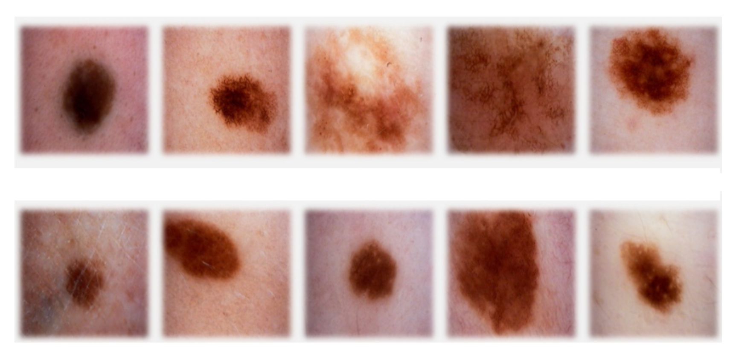
classification
sign of cancer
top row malignant
bottom row benign
Machine Learning Methods for Biomedical Data (D012554)

Slide 16
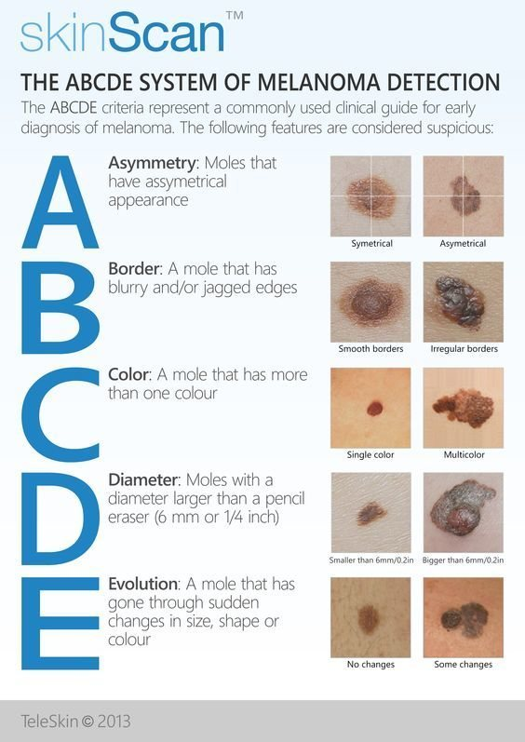
classification
Machine Learning Methods for Biomedical Data (D012554)

Slide 17
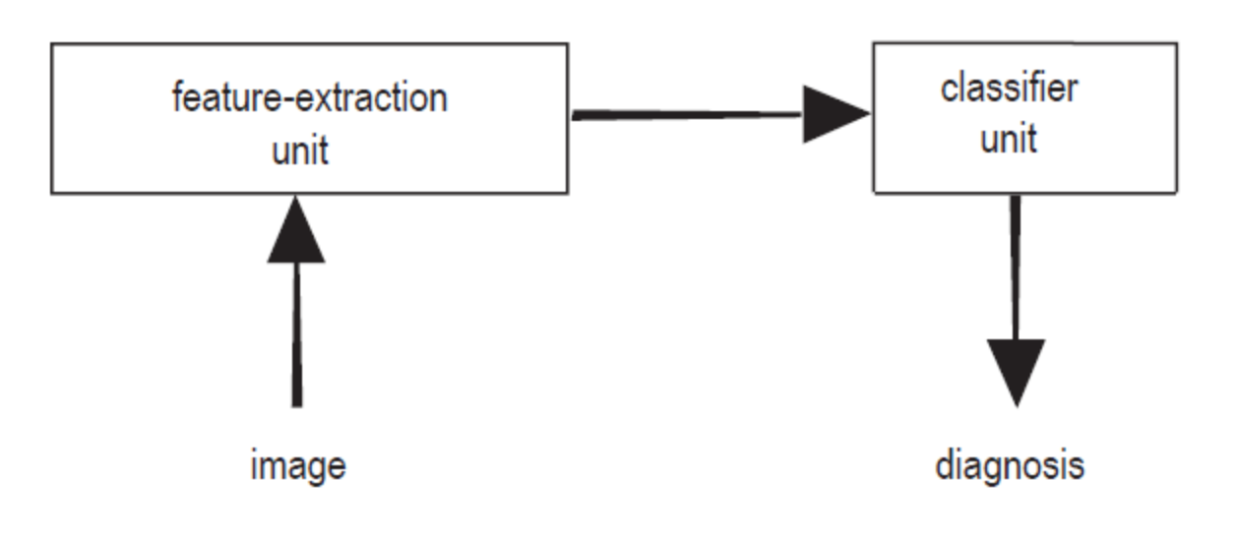
classification: terminology
feature extraction: features (a.k.a. properties or attributes)
data set, sample (a.k.a. example, instance or data point), label (a.k.a. target)
Machine Learning Methods for Biomedical Data (D012554)

Slide 18
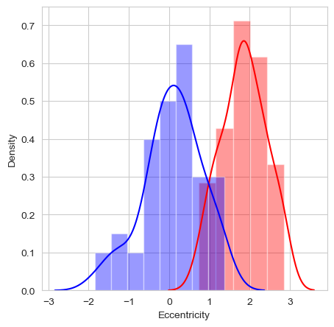
classification: a feature
feature: eccentricity of lesion (how nearly circular the lesion is)
Machine Learning Methods for Biomedical Data (D012554)

Slide 19

classification: the model
feature: eccentricity of lesion (how nearly circular the lesion is)
model: threshold t
Machine Learning Methods for Biomedical Data (D012554)

Slide 20
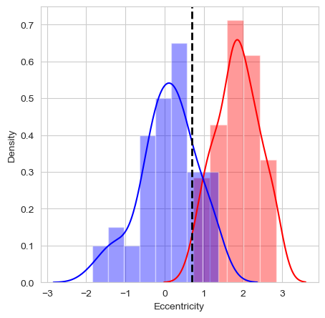
classification: the model
feature: eccentricity of lesion (how nearly circular the lesion is)
model: threshold t: consequence of the predictions
Machine Learning Methods for Biomedical Data (D012554)

Slide 21
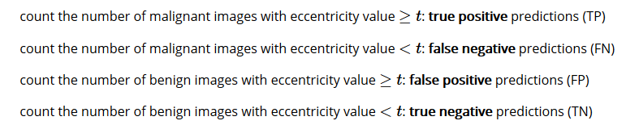
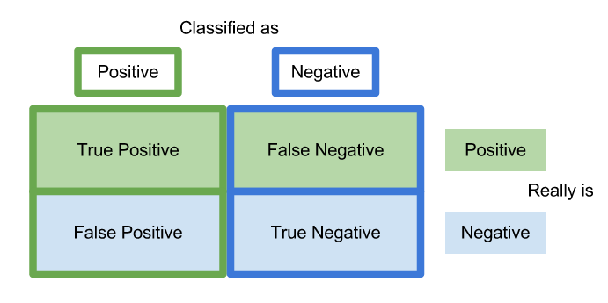
classification: prediction errors
malignant: positive class
benign: negative class
Machine Learning Methods for Biomedical Data (D012554)

Slide 22
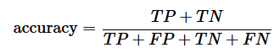
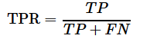
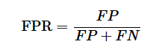
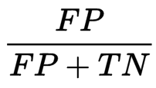
classification: prediction errors
Machine Learning Methods for Biomedical Data (D012554)

Slide 23
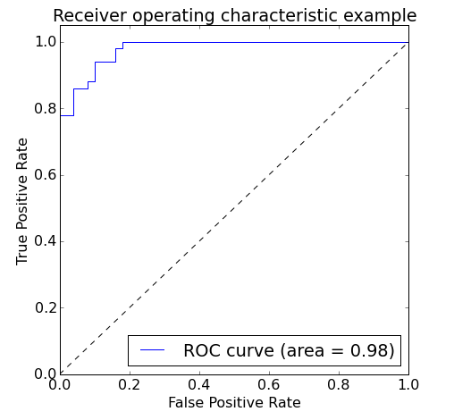
classification: prediction errors
model that classifies all images as malignant: TPR=1 and FPR=1
model that classifies all images a benign: TPR=0 and FPR=0
vary threshold t
Area Under the Curve (AUC)
Machine Learning Methods for Biomedical Data (D012554)

Slide 24
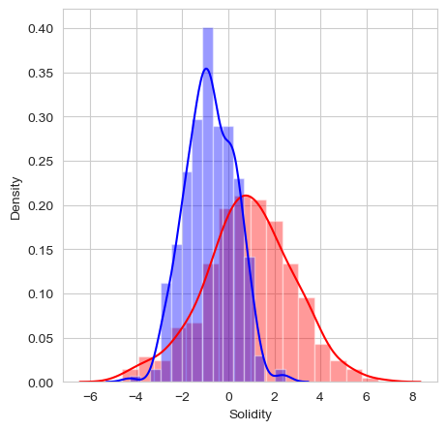
classification: multi-dimensional
add another feature?
feature vector X
Euclidean vector space
Machine Learning Methods for Biomedical Data (D012554)

Slide 25
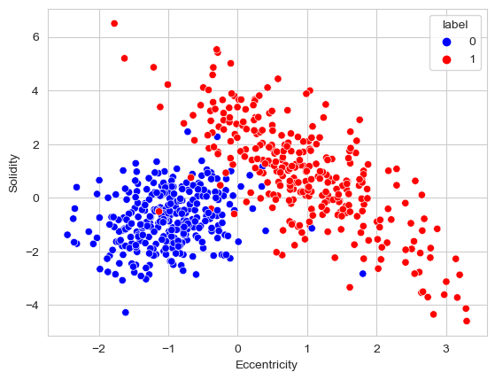
classification: multi-dimensional
feature vector X
Euclidean vector space
Machine Learning Methods for Biomedical Data (D012554)

Slide 26
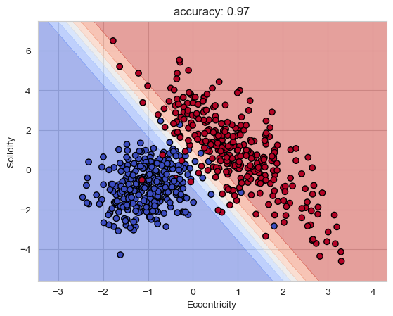
classification: multi-dimensional
linear decision boundary
blue region malignant, red region benign
yet more features
can’t look at the decision boundary
more complex
Machine Learning Methods for Biomedical Data (D012554)

Slide 27
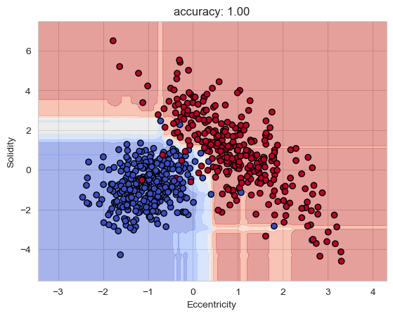
classification: model complexity
unseen external images
generalization
overfitting
Machine Learning Methods for Biomedical Data (D012554)

Slide 28
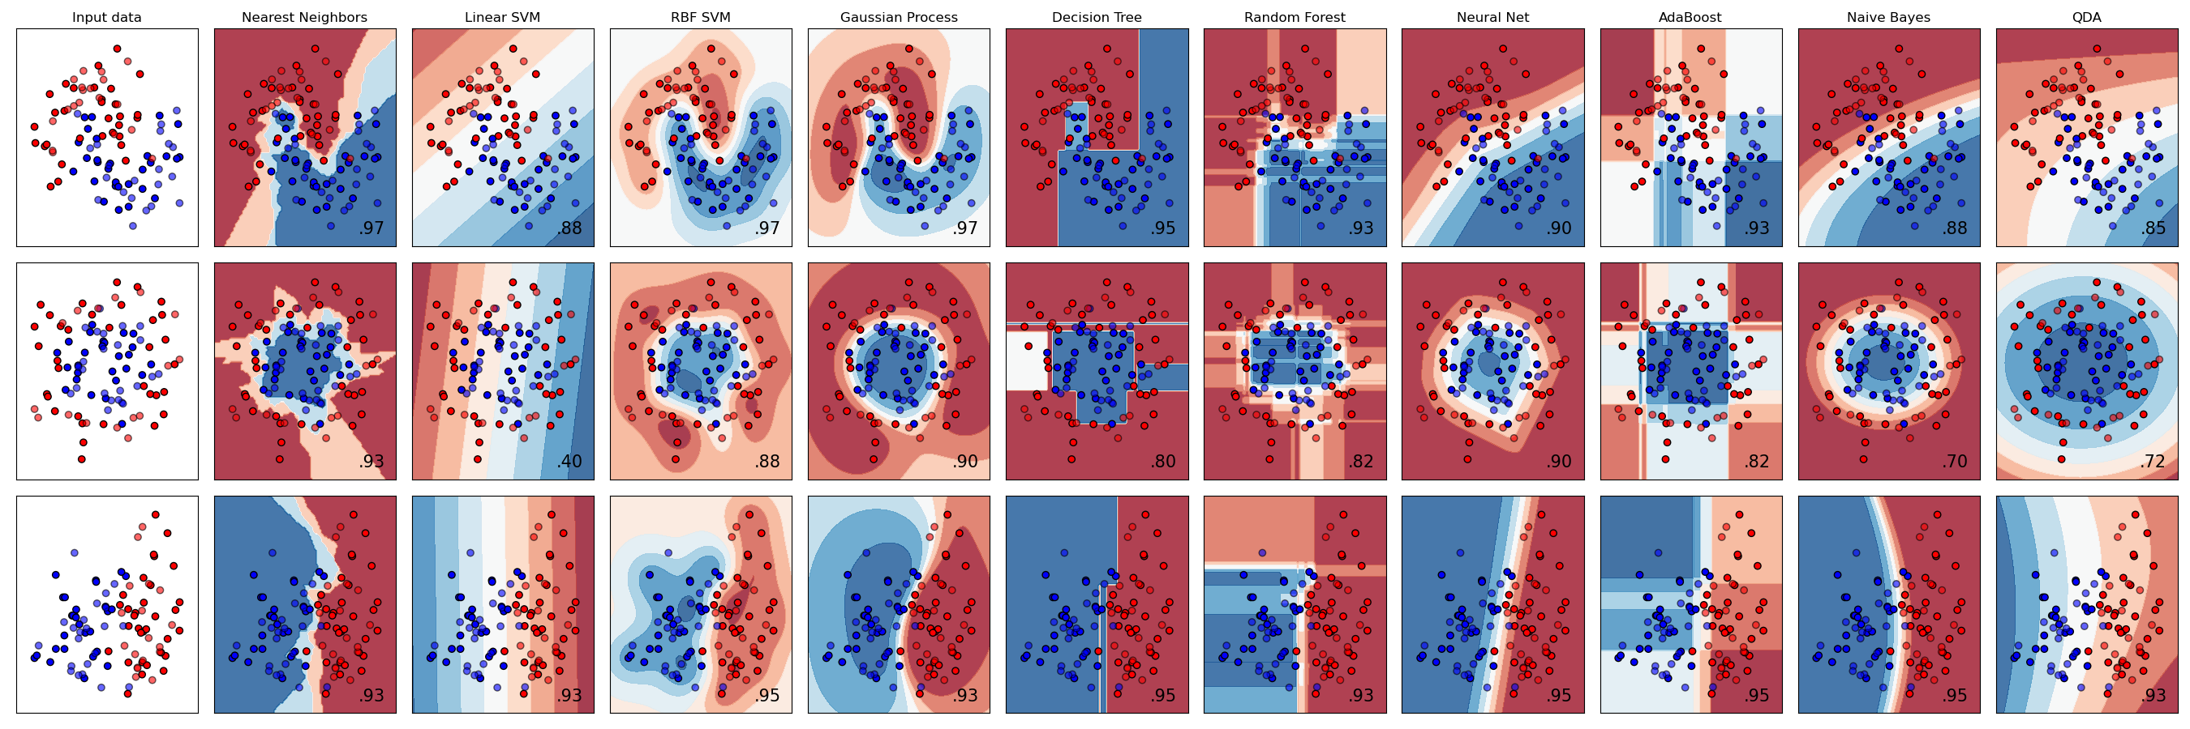
scikit-learn
Machine Learning Methods for Biomedical Data (D012554)

Slide 29
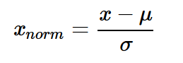
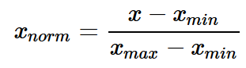
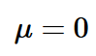
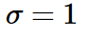
data normalization
make all features same scale
Eccentricity [0,100], Solidity [-5,7]
weights all features equally in their representation
standardization
min-max scaling: scale the features to a fixed range
Machine Learning Methods for Biomedical Data (D012554)

Slide 30
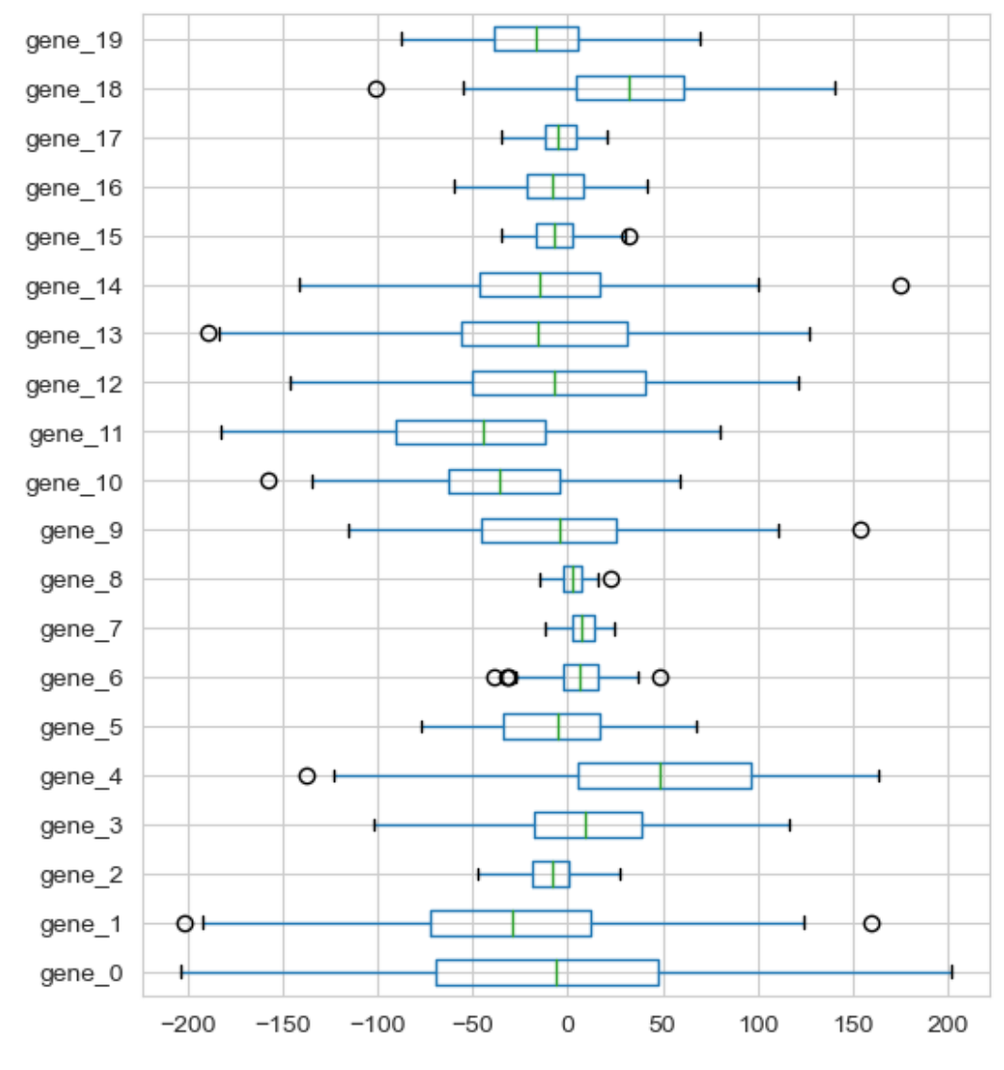
data normalization
Machine Learning Methods for Biomedical Data (D012554)

Slide 31
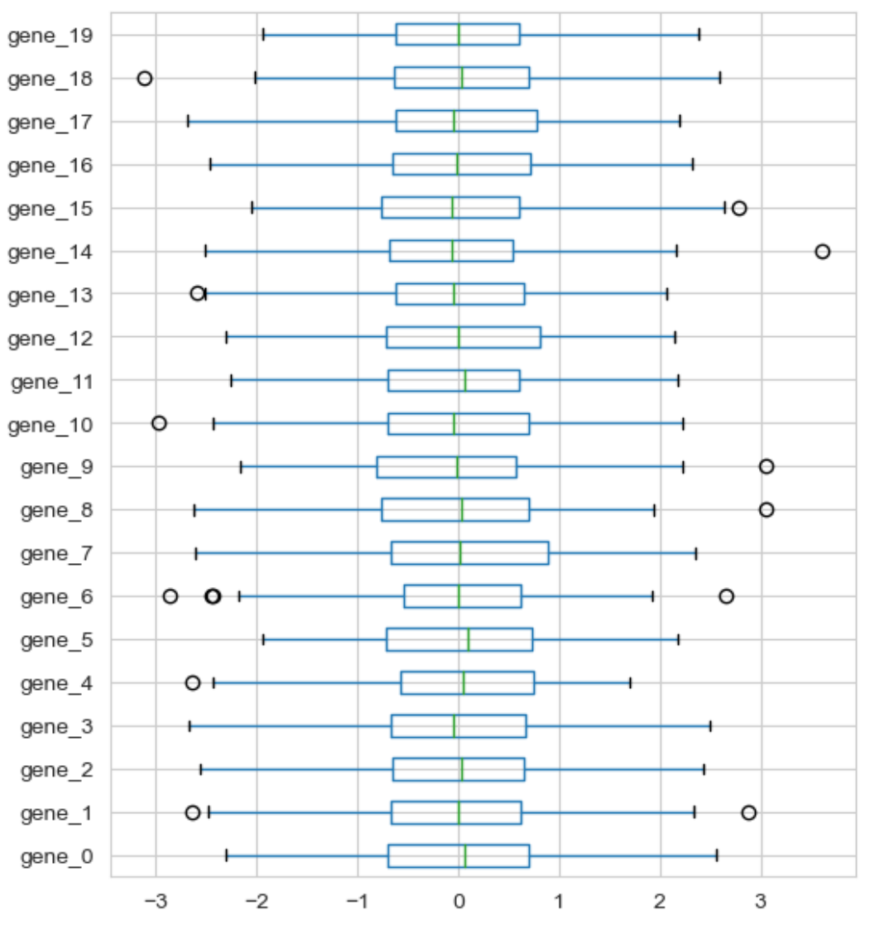
data normalization: standardization
Machine Learning Methods for Biomedical Data (D012554)

Slide 32
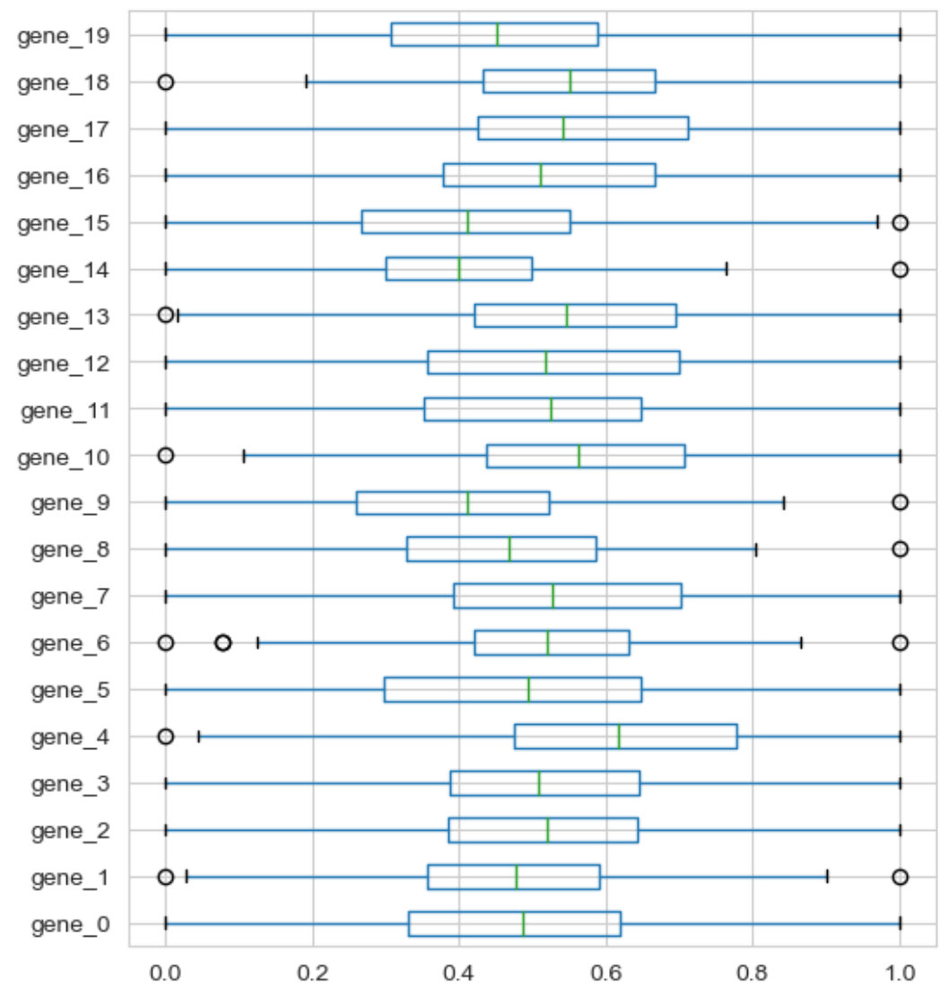
data normalization: min-max scaling
Machine Learning Methods for Biomedical Data (D012554)

